Slide 1
Data Modeling
Entity Relationship Diagramming / Semantic Data modeling

Slide 2
Components of ERD (Entity Relationship Diagram) or Data Modeling (DM)
The main components of the ER model are entity, attribute, and relationship. The notations used to show these components are as follows
Oval represents an entity
Weak entity
Lines connecting different
types of relationships
offer
Name the relationship between
Department
Course
Two entities placed on the top
of the line which connects the two entities

Slide 3
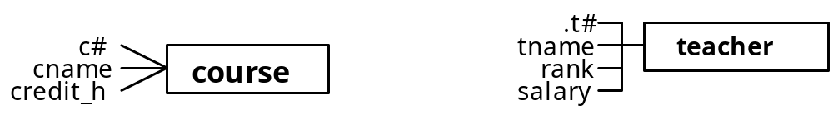
ENTITY
An entity is a "thing" distinguishable from other things.
Each entity is a singular name to represent a group of objects where information is kept such as; student or department.
ATTRIBUTE
Each attribute describes an entity.
Each entity has zero or more attributes.
In the following diagram the name of the attributes are written next to the entity it describes and a line is drawn to show the association between entity and attribute.
Each enterprise may look at an entity differently from other enterprises or perhaps each user within the same enterprise has a different view of the same entity.
An entity name can be loosely interpreted as a file name.

Slide 4
RELATIONSHIP
Entities are related to each other.
Different types of relationships may exist between different types of entities.
A relationship usually is a binary relationship. This means only two entities can be involved
The relationship between department and employees drawn by the line with arrow at each end and is called “manages”
d#
manages
e#
dname
department
employee
ename
phone#
address
addr
Degrees of a relationship.
Degree of a relationship represents how many instances of one entity may describe the other entity and vice versa. There are three different degrees of the relationship:
1. One and Many (1-M)
2. One and One (1-1)
3. Many and Many (M-M)

Slide 5
ONE AND MANY (1-M) RELATIONSHIP
In the following diagram, a 1-M relationship exists between course and department.
This can be read as every specific department offers many courses but every specific course can be offered by only one department.
c#
offer
d#
cname
course
department
dname
credit_h
address
director
ONE AND ONE (1-1) RELATIONSHIP
In the following diagram, a 1-1 relationship exists between employee and department.
This can be read as one employee - an instance of employee entity - is the manager of the department entity.
Or every department entity has only one manager.
Instance could be interpreted as a record in a file.
d#
manages
e#
dname
department
employee
ename
phone#
address
addr

Slide 6
GUIDELINES FOR PROPER DM DESIGN
Every DM should follow these guidelines. :
Every entity has to have a unique name within each DM
2. Every DM should have a unique name (Schema name)
3. Every entity has to have at least one candidate identifier.
4. All attribute names within an entity should be unique. This means that the same attribute name can be used in different entities within a given DM.
5. Relationship names between two entities should be unique. This means that similar relationship names can be used between other entities within a given DM.
6. All the names used in the DM design should be meaningful and natural.
7. Only one-and-one (1-1) relationship and one-and-many (1-m or m-1) relationship should be used. This means no many- to-many relationship (M-N) should exist in your DM.
8. All the entity names and attribute names used in the DM should be singular. Plural entity names will interfere with analyzing the relationships between two entities and plural attribute name is an indication of establishing a new entity for that attribute.

Slide 7
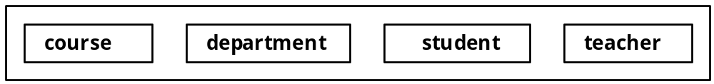
Identifying the entities

Slide 8
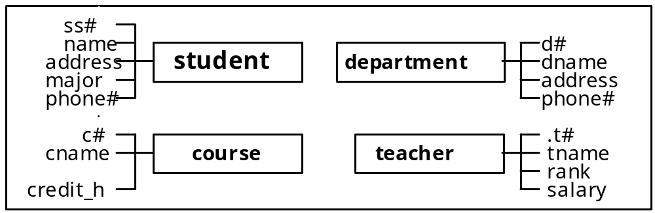
Identifying the attributes for each entity

Slide 9
Candidate keys
Select an identifier(s) for every entity
³ id#
³
addr#
•
ss#
address
•
st-addr
student
name
•
city
address
•
state
major
•
zip
phone#
• year
• sect#
•
c#
•
c#
enrollment
• ss#
enrollment
• ss#
grade
•
semester
grade
Composite identifier

Slide 10
Identifying the relationship between entities
M-M relationship
working/works
•
ssn
name
c#
•
address
cname
phone#
credit-h
student
course
has/taken
1-M relationship
offer
•
•
d#
ssn
st-teacher
dname
name
advise
address
rank
phone
salary
employed
department
teacher
director
Relationship name

Slide 11
Weak Entities: Converting M_M relationship to two 1_M relationships
working
works
st-employement
•
•
•
ssn
name
c#
•
enrollment
address
cname
phone#
credit-h
•
•
student
course
has
taken
offer
•
d#
ssn
•
dname
name
st-teacher
address
rank
advise
phone
salary
employed
department
teacher
director

Slide 12
Adding attributes to Weak entities and explore the relationships
tutor
ss#
•
c# •
name
cname
address
major
credit_hr
grade
phone#
¨• year
student
course
enrollment
• quarter
• sect#
has
taken
•
•
•
d#
teaches
advise
offer
dname
teacher_
address
student
phone
.t#
•
tname
teacher
department
rank
salary
director
employed
hrs_worked
date
•
working
works
•
st-employment
•

Slide 13
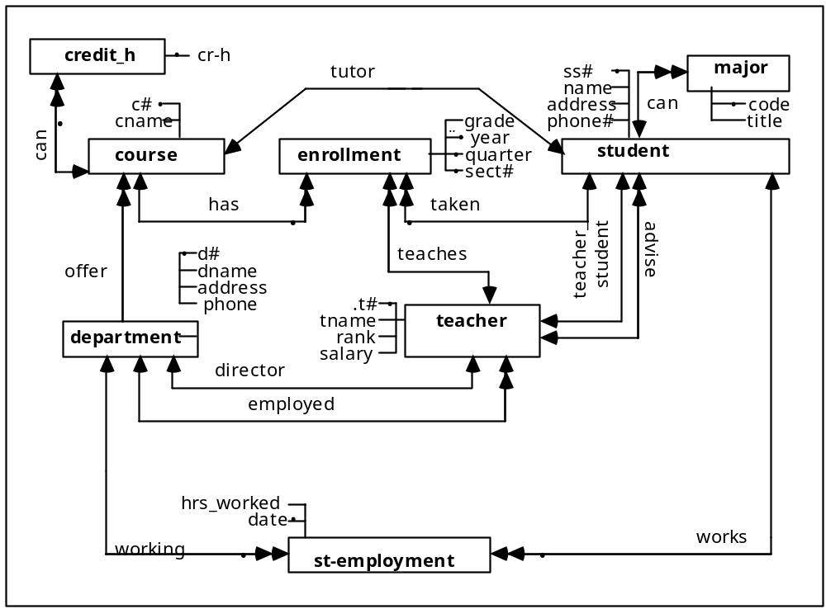

Slide 14
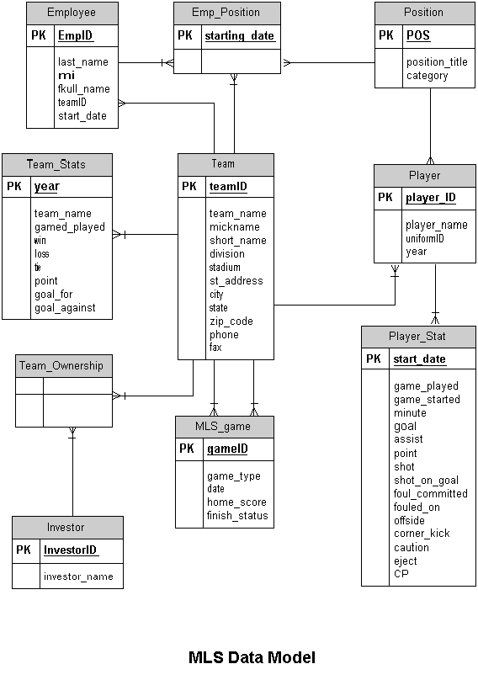
InfoGem

Slide 15

CONVERSION OF DM TO RELATIONAL DATABASE
The basic conversion rules are fairly simple.
ENTITY <<===>> RELATION NAME (table name or file name)
WEAK ENTITY <<===>> RELATION NAME (table name or file name)
ATTRIBUTE <<===>> ATTRIBUTE (table column or field)
RELATIONSHIP <<===>> ATTRIBUTE as Foreign Key (FK)
IDENTIFIER <<===>> PRIMARY KEY (PK)
In the following diagram, the entity student with two candidate identifiers is converted to a relational model.
The name of the entity will be the name of the relation (table) and all of the attributes of the entity will be placed inside a bracket to represent them as attributes of the table.
The identifier or candidate identifier will be high-lighted with some kind of symbol such as underline or double lines.

Slide 16
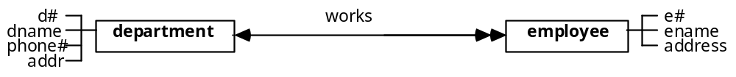
CONVERSION RULES FOR RELATIONSHIP BETWEEN ENTITIES
Mapping relationships between entities should be done based on the degree of the relationship between entities. These degrees are 1-M, 1-1, and M-M.
Conversion rule for 1-M relationship
For one-many relationships, one instance of one entity which has many instances of the other entity should have its identifier present in the other entity.
In other words, the parent entity should have its identifier present in all its children.
In the following diagram, every department has many employees (department is the parent), therefore its identifier will be among the attributes of employee entity. Identifier of the department in the employee entity is called the foreign key attribute.
department (d#, dname, phone#, addr)
employee (e#, ename, address, d#)

Slide 17
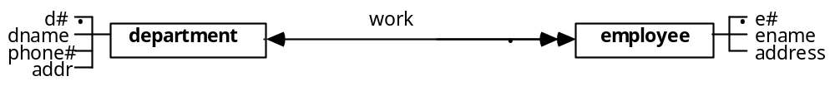
Conversion rule for 1-M relationship – continue 1
If there was an identifier symbol in the relationship, then the identifier of the parent and the identifier of the child together will act as the identifier of the child.
This type of relationship is presented in the following diagram. Every employee is identified with its identifier (e#) and the identifier of the department which that employee is working.
department (d#, dname, phone#, addr)
employee (e#, ename, address, d#)

Slide 18
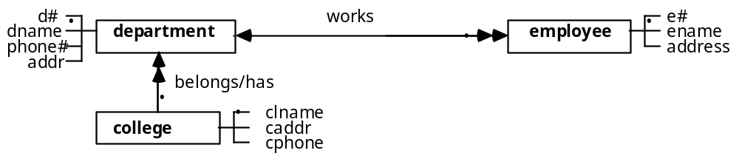
Conversion rule for 1-M relationship – continue 2
In the diagram below, the previous example is expanded to show the series of 1-M relationships with parents identifying their children.
In this example, every college has many departments. Here we are assuming that each department will be identified with its college.
The snowball effect of these series of relationships with identifiers is shown. The only way to break this accumulation of identifiers is by introducing the customized identifier.
college (clname, caddr, cphone)
department (d#, dname, phone#, addr, clname)
employee (e#, ename, address, d#, clname)

Slide 19
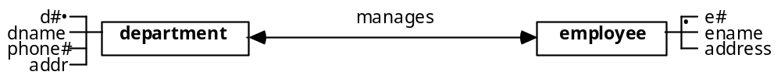
Conversion rule for 1-1 relationship
There are several possible ways to perform this conversion however, some of them are not very desirable and should be avoided.
We can keep the identifier of employee table (e#) in department table as FK (option # 1) OR
keep the identifier of department table (d#) in employee table as FK (option # 2) OR
keep the identifier of each table in separate tables (similar to a weak entity)
In order to decide which option is the best option for the conversion, we should analyze each entity.
Option#1: is acceptable because every department has to have a manager
Option#2: is not a good choice because there are many employees for a given department and only one of them can be the manager. This will result in a lot of unused space and it is also very difficult, if not impossible, to check for data integrity (to control the accuracy of the values stored) for this attribute in the employee table.
Option#3: is acceptable because only one pair of (e#,d#) will be kept for the same number of departments.

Slide 20
Conversion rule for 1-1 relationship – continue 1
Option 1: PK of the employee table as FK in the department table
department (d#, dname, phone#, addr, e#)
employee (e#, ename, address)
Option 2: PK of the department table as FK in the employee table
department (d#, dname, phone#, addr)
employee (e#, ename, address, d#)
Option 3: new weak entity “manager” with PKs of employee and department tables as its composite PK
department (d#, dname, phone#, addr)
employee (e#, ename, address)
manager (d#, e#)

Slide 21
CONVERSION RULE FOR M-M RELATIONSHIP
This is very straightforward. The weak entity will be converted to a table. The identifier of the table would be the identifier of the original two entities plus any local identifiers the weak entity may have.
department (d#, dname, phone#, addr)
employee (e#, ename, address)
employed (d#, e#)
has
works
•
employed
•
d#
•
•
e#
dname
department
employee
ename
phone#
address
addr

Slide 22
CONVERSION RULE FOR M-M RELATIONSHIP – continue 1
The following diagram is a situation where the weak entity has some attributes and college entity owns the department entity.
college (clname, caddr, clphone,)
department (d#, dname, phone#, addr, clname)
employee (e#, ename, address)
employed (d#, e#, date, hrs_worked, clname)
has
•
•
works
employed
hrs-worked
•
date
d#
•
•
e#
dname
department
employee
ename
phone#
address
addr
•
•
clname
college
caddr
cphone

Slide 23
CREATE TABLE location
(locid NUMBER(5) CONSTRAINT location_locid_pk PRIMARY KEY,
bldg_code VARCHAR2(10) CONSTRAINT location_bldg_code_nn NOT NULL.
Room VARCHAR2(6) CONSTRAINT location_room_nn NOT NULL,
Capacity NUMBER(5) CONSTRAINT location_capacity_nn NOT NULL.);
CREATE TABLE Faculty
(fid NUMBER(5) CONSTRAINT faculty_fid_pk PRIMARY KEY,
fname VARCHAR2(30) CONSTRAINT faculty _fname_nn NOT NULL.
locid NUMBER(5) CONSTRAINT fculty_locid_fk REFERNCES location(locid),
fphone VARCHAR2(10),
frank CHAR(4) CONSTRAINT faculty_frank_cc CHECK ((frank=’ASSOC’ OR (frank = ‘FULL’) OR frank=’ASST’ OR (frank = ‘INST’));

Slide 24
Create a table with a composite primary key
create TABLE ITEM_SOLD_MONTHLY_SUMMARY
(
ITEMNUMBER VARCHAR2(50) NOT NULL,
YEAR VARCHAR2(6) NOT NULL,
LOCNCODE VARCHAR2(15)NOT NULL,
constraint item_sold_Mth_Sum_PK primary key (ITEMNUMBER, YEAR, LOCNCODE)
);

Slide 25
Viewing the tables you own:
SELECT table_name FROM user_tables; <enter>
User_table is a system database table. It has all users’data tables.
The table_name is one of the fields.
Viewing the field definitions
DESCRIBE commands will displays all attributes that exist in your table
DESCRIBE faculty;
Viewing Constraint information:
SELECT CONSTARINT_NAME
FROM USER_CONSTRAINTS
WHERE TABLE_NAME = ‘faculty’;
To rename existing tables:
RENAME <oldtablename> to <newtablename>;

Slide 26
Adding fields to existing tables
ALTER TABLE <tablename>
ADD <fieldname><data declartion>
CONSTRAINT <integrity constraints>
CONSTRAINT <value constraints>;
Modifying existing fields:
ALTER TABLE <tablename>
MODIFY (<fieldname><new data declaration>);
ALTER TABLE FACULTY
MODIFY (frank varchar2 (6));
To add the CHECK conditions to an existing table:
ALTER TABLE STUDENT
ADD sclass CONSTRAINT student_sclass_cc CHECK ((sclass = ’UG’) OR (sclass = ’GR’));

Slide 27
CREATE INDEX
We can create indexes for fast retrieval of the query.
While making indexes consider whether that
column will be used frequently, or
column contains wide range of values, or
column contains large number of null values.
CREATE INDEX TEA_PHO_INX ON TEACHER(PHONE);
We can also create an index on multiple columns.
CREATE INDEX STU_SNA_SNB_INX ON STUDENT(SNAME,SNUMB);
We can create UNIQUE index on column or columns.
CREATE UNIQUE INDEX DEPT_NAM_INX ON DEPARTMENT(DNAME);

Slide 28
USER_CATALOG:Tables, Views, Synonyms and Sequences owned by the user
SELECT *
FROM USER_CATALOG;
USER_ALL_TABLES: Description of all object and relational tables owned by the user's
DESC USER_ALL_TABLES
SELECT TABLE_NAME, TABLESPACE_NAME
FROM USER_ALL_TABLES;
ALL_TABLES: It gives the information about tables which are owned by user.
SELECT OWNER, TABLE_NAME
FROM ALL_TABLES
WHERE OWNER='DB2000GENUSE';
ALL_TAB_COLUMNS: It gives the information about tables and their columns which are owned by a user
COLUMN TABLE_NAME FORMAT A25
COLUMN COLUMN_NAME FORMAT A15
COLUMN DATA_TYPE FORMAT A15
COLUMN DATA_LENGTH FORMAT 999
SELECT TABLE_NAME, COLUMN_NAME, DATA_TYPE, DATA_LENGTH
FROM ALL_TAB_COLUMNS
3 WHERE OWNER = 'DB2000GENUSE';

